Slide 1
So what do we do now?
Johnstown Community Forum
August 8, 2022

Slide 2
Kay Spergel, M.Div., MA, LISW-S
kspergel@mhrlk.org

Slide 3
The pandemic
A very, very long crisis

Slide 4
March - April 2020

Slide 5
crisis
Any situation in which a person perceives a sudden loss of control or ability to use effective problem-solving and coping skills.

Slide 6
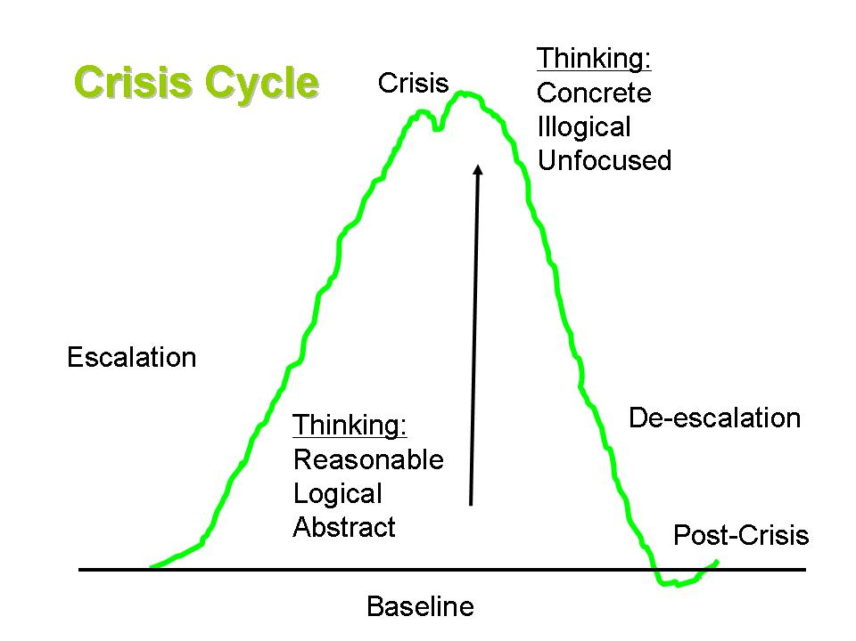

Slide 7
May - June 2021

Slide 8
Understanding Crisis Maslow’s Hierarchy of Needs
Self-actualization
Morality, creativity, spontaneity, acceptance, experience purpose
Self-esteem
Confidence, achievement, respect of others, the need to be a unique individual
Love and Belonging
Friendship, family, intimacy, sense of connection
Safety and Security
Health, employment, property, family , and social stability
Basic Physiological Needs
Breathing, food, water, shelter, clothing, sleep

Slide 9
September 2021 – march 2022

Slide 10
question
What has happened to you, me, our community?

Slide 11
Trauma
Any incident that is experienced by a person that is perceived as traumatic
Acute Trauma: Results from a single stressful or dangerous event
Chronic Trauma: Results from repeated and prolonged exposure to highly stressful events
Complex Trauma: Results from exposure to multiple traumatic events

Slide 12
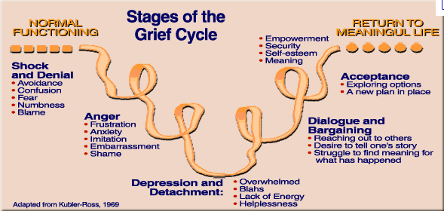

Slide 13
question
Where are we have we been? Where are We? Where are we going?

Slide 14
August 2022

Slide 15
A truth of life
Whether is it good or bad, positive or negative, the one constant in life is change. It is inevitable. Being creatures of habit, change pushes us out of our comfort zone, requiring us to make decisions and take action

Slide 16
The art of carving transformation out of crisis
Transformation is the process of enacting change and growth
Uses what has been learned and changed from the crisis
Faces that change head on and embraces it

Slide 17
So…do we really like change?
Most of us like change as long as we are in control of it.
Most people feel comfortable doing what they have always been doing
Many genuinely believe what they’ve been doing, and how they’ve been doing it, is the best possible way to do it
We may fear change because we fear that we might lose what’s associated with that change

Slide 18
So…Do we really like change?
People resist change because they believe they will lose something of value or fear they will not be able to adopt to the new ways.
Even positive change can be upsetting to some
This is because a once-comfortable way of life will soon look different.
Your are put out of your comfort zone, which makes it harder to deal with change.
This brings stress which may become overwhelming

Slide 19
Transformation
Change can teach us to adapt and help us develop resilience, but only if we understand our own capacity for growth and learning
When change makes us better, it’s because we have learned how to turn a challenging situation to our own advantage, not merely because change happens. One of life's constants is change.
Transformation helps us move forward

Slide 20
moving

Slide 21
healing
Resiliency and self-care

Slide 22
“For the forest to be green, each tree must be green”
George Harrison

Slide 23
stress
Feeling irritation, anger, or in denial
Feeling uncertain, nervous, or anxious
Lacking motivation
Feeling tried, overwhelmed, or burned out
Feeling sad or depressed
Having trouble sleeping
Having trouble concentrating

Slide 24
Thriving
Assess yourself
Savor and celebrate small things
Practice gratitude
Be kind – practice empathy
Find purpose in everyday routines
Breaks from Media
Connect with others
Reach out if you need support

Slide 25
Thriving
Protective Factors
Social Connectedness – Family, friends, support groups, faith-based community
Leisure skill activities
Volunteering
Exercise
Nutrition
Sleep
Mindfulness & mediation or prayer
Relaxation training
Education – self help books

Slide 26
Resources - local
Pathways 211: Dial 211 or 800-544-1601
Text your Zip Code to 898-211(24 hours)
Resource Directory: www.211pathways.org
Mental Health and Recovery for Licking and Knox Counties: 740 - 522 -1234

Slide 27
Resources – state & National
National Crisis Line: Call or text 988
Ohio Association of County Behavioral Health Authorities (OACBHA): 614-224-1111 or oacbha.org
Ohio Department of Mental Health and Addiction Services (OhioMHAS): 1-877-275-6364 or mha.ohio.gov

Slide 28
resources - – state & National
Ohio Council of Behavioral Health & Family Services
614-228-0747 or ohiocouncil-bhp.org
National Alliance on Mental Illness (NAMI)
www.nami.org
Ohio NAMI: 1-800-686-2646 or www.namiohio.org
Mental Health America: www.mentalhealthamerica.net

Slide 29
resources
Substance Abuse and Mental Health Services Administration: www.samhsa.gov
Narcotics Anonymous: www.na.org
Alcoholics Anonymous: www.aa.org
National Council for Behavioral Health: www.thenationalcouncil.org
National Institute of Mental Health: www.nimh.nih.gov
National Institute on Drug Abuse: www.drugabuse.gov

Slide 30
Johnstown schools
Shannon cox, Jenny herr & Kendra Arbogast

Slide 31
Johnstown high school
Juniors receive the Signs of Suicide presentation in the fall and freshmen in the spring - that covers approximately 240 students
No Hate Tour - positive behavior/anti-bullying - to all students (500+)
Anti-vaping curriculum through Pathways delivered through gym and music classes, capturing approximately 70% of students
Teachers trained through PD on trauma and response strategies
Health class is graduation requirement and does address mental health, dating safety, as well as substance abuse risks
Confidential student support requests accessible to families, students, and staff

Slide 32
Johnstown middle school
All 7th grade students receive Mental Health America's "Signs of Suicide" programming each year. (approximately 135 students per year)
All 8th grade students hear Pathway's anti-vaping presentation annually. (approximately 135 students per year)

Slide 33
Johnstown elementary school
Second Step Bullying Prevention Unit for all students (K-5) to begin the school year.
Social-emotional instruction and support through classroom lessons, small groups, and with students individually.
Cornerstone of Hope has lead a grief group.
ROX (Ruling Our Experiences) for 5th grade girls.
Ron Derry GOOD for all 4th grade students. (about 135 students)
Triple P (Positive Parenting Program) as requested by parents.

Slide 34
Contact information
High School
Middle School
Shannon E. Cox MSW, LSW
Student Support Specialist
740-967-2721 ext. 2307
scox@jmk12.org
Jenny Herr
School Counselor
740-967-8766 ext. 3304
jherr@jmk12.org
Elementary & Intermediate School
Kendra Arbogast
Student Support Specialist
karbogast@jmk12.org
JES: 740-967-5461 ext 4311
JIS: 740-966-3055 ext 5113

Slide 35
BEHAVIORAL HEALTHCARE PARTNERS Dr. Kate St. James, President & CEO

Slide 36
KNOW US, BEFORE YOU NEED US

Slide 37
Who we are…
Your community behavioral health provider
Serving Licking & Knox Counties for nearly 70 years
501(c)(3) – charitable non-profit
150 staff across both counties
10 facilities

Slide 38
Who we serve…
Adults
Children
Families
Serve over 6,000 people every year

Slide 39
How we serve the community…
Adult Services
Youth services
Outpatient
Behavioral Health Urgent Care Clinics
Counseling
Psychiatric Care (medication prescribing)
Care Coordination
Crisis
Employee Assistance Program
Vocational Training
Student Internships
Residential (in-patient) Care
Addiction Treatment
Mental Health Housing
Outpatient
Behavioral Health Urgent Care Clinics
Counseling
Care Coordination
Psychiatric Care (medication prescribing)
Student Internships
Community Based
Schools (Therapy, Care Coordination, Consultation)
Early Childhood Mental Health
Home-based Services with the Child and Family
Crisis Services

Slide 40
24/7 Crisis Help
If you or someone you know is in a mental health or alcohol/drug crisis, please access our Crisis Intervention Services by dialing 2-1-1 or dialing 800-544-1601 24/7/365.
To text, send your zip code to 898211.

Slide 41
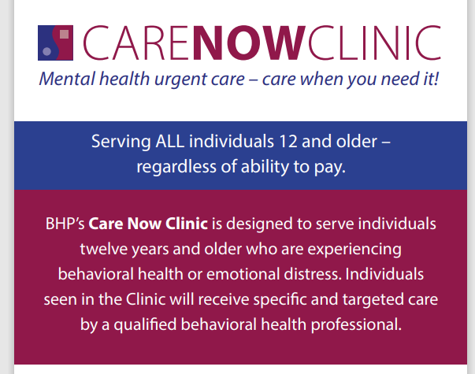
Behavioral Health Urgent Care
Locations:
Newark, 104 E. Main Street, 740.963.3590
Mount Vernon, 206 S. Mulberry Street, 740.324.7800
Johnstown, TBA

Slide 42
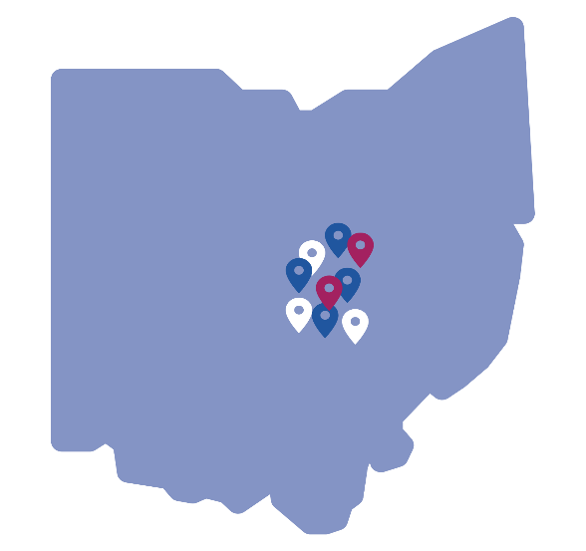
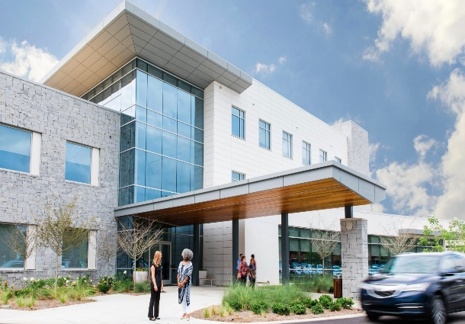
Preparing for the future…
Better serving our communities
More behavioral health urgent care clinics
Behavioral Health Emergency Center

